Slide 1
The IEEE Global Initiative for Ethical Considerations in Artificial Intelligence and Autonomous Systems
An Introduction (March, 2017)

Slide 2


Slide 3


Slide 4
“科技与美丽的结合 或将衍生巨大商业机会 人工智能时代，机器的深度学习瞬间就能为用户定制手绘画像，用智能与速度满足广大消费群体的手绘需求，可以预见，xx“一秒转手绘”将对传统手绘服务交易市场产生巨大冲击，该特效上线后，朋友圈、微博已经迅速掀起一轮晒图热潮。” 在淘宝上搜索“手绘”二字会发现，不少卖家都因为买家定制手绘图月销量达数千单，微信上也有很多手绘微商，定制手绘画像在消费市场上需求量很大，然而买家需要花费数十元到数百元之间、等上好几天才能够拿到个人的手绘画像。”

Slide 5


Slide 6
“我们用谷歌训练AlphaGo的技术来处理照片。”

Slide 7
“技术从对焦、降噪、颜色和美颜多个维度对照片进行处理。我看到的是，对人像大数据的处理算法一直在追求“精耕细作”，围绕这一领域做到极致，这是应用人工智能的正道”。

Slide 8
“ 人像处理技术在实际应用领域也有很大的发展前景——这个技术让机器可以辨识人，进而可被应用到智能客服、无人销售、安保安防、公安刑侦诸多领域，譬如让计算机对全国机场港口车展摄像头进行实时的人像跟踪来发现通缉犯，再比如前几天爆红的Amazon Go无人超市也大量应用了人像识别技术。如果再放大到图像技术领域，人工智能应用空间就更大了，甚至可以说50%的人工智能应用都与图像有关系，机器人、无人车、无人机、智能交通……”

Slide 9
Embedding values into AI system
Identify values and eliciting the specific value of that community affected by AIS ，issues and approach
Issue 1: Not universal but specific to community →delineate, different sets
Issue 2: “Moral overload” (Multiplicity and conflicts :money? Law? Social? normal?) →prioritize :
larger target population →common good principle (e.g. auto driving)
Clear and explicit rationale in engineers’ design for evaluation
dynamically change priority rank → user input
Issue 3 : built in data and algorithmic bias that disadvantage certain group → special attention
new ontology and manipulation risk (following strangest request from robot)
Design instilled bias (agenda, color…) intended or not (via sense, process, respond)
Implement values and norms of that community
Evaluating alignment between human and AIS

Slide 10
What/how it happened with those pictures
It is very easy to have built-in bias in AIS due to data (e.g. a system depends on face recognition trained on faces of specific skin tone and facial structure may work incorrectly)
Also from values held by designers
Recommendation
Adopting more inclusive design principle
system that sense of data of difference skin tone and structure, etc.
Introduce into design process the members who may be disadvantaged by the system

Slide 11
IEEE PROJECT P7003 - Algorithmic Bias Considerations
This standard is designed to provide individuals or organizations creating algorithms, largely in regards to autonomous or intelligent systems, certification oriented methodologies to provide clearly articulated accountability and clarity around how algorithms are targeting, assessing and influencing the users and stakeholders of said algorithm.
Certification under this standard will allow algorithm creators to communicate to users, and regulatory authorities, that up-to-date best practices were used in the design, testing and evaluation of the algorithm to avoid unjustified differential impact on users.

Slide 12
P7003 - Algorithmic Bias Considerations
This standard describes specific methodologies to help users certify how they worked to address and eliminate issues of negative bias in the creation of their algorithms, where "negative bias" infers the usage of overly subjective or uniformed data sets or information known to be inconsistent with legislation concerning certain protected characteristics (such as race, gender, sexuality, etc);
or with instances of bias against groups not necessarily protected explicitly by legislation, but otherwise diminishing stakeholder or user well being and for which there are good reasons to be considered inappropriate.

Slide 13
P7003 - Algorithmic Bias Considerations
Possible elements include (but are not limited to):
benchmarking procedures and criteria for the selection of validation data sets for bias quality control;
guidelines on establishing and communicating the application boundaries for which the algorithm has been designed and validated to guard against unintended consequences arising from out-of-bound application of algorithms;
suggestions for user expectation management to mitigate bias due to incorrect interpretation of systems outputs by users (e.g. correlation vs. causation)

Slide 14

The IEEE Global Initiative is part of IEEE’s Technology Ethics landscape
Professional Guidelines
Help define intended behavior by professionals in the field
IEEE Code of Ethics
Software Engineering CoE
Recent AI Now and White House Reports
Code of Ethics
IEEE Ad Hoc Committee on Ethics Programs
Professional Ethics
Technology Ethics
Behavioral Impacts
Impact of (and response to) professional behaviors in the context of the guidelines
Research Ethics and Plagiarism
Business Ethics
Safety/labor/equality considerations and policy
Ethics Education
Technology Impacts
Ethical/societal impacts of the technologies themselves
IEEE Global Initiative for Ethical Considerations in Artificial Intelligence and Autonomous Systems
Ad Hoc on Design for Ethics
Events/publications (various IEEE organizational units)
Notes:
The overall technology-related ethics landscape covers three key areas, each of which have IEEE engagement:
[click] professional guidelines that help define intended behavior by professionals in the field;
[click] the impact of (and response to) professional behaviors in the context of those codes of ethics; and,
[click] the ethical and societal impacts of the technologies themselves.
[click] These are interdependent categories, with each influencing and/or being influenced by the others.
[click] A new IEEE Ad Hoc Committee on Ethics Programs has been created by the IEEE Board of Directors to coordinate and create synergy across the entire IEEE between these various activities.
[click] In addition, a new institute-wide umbrella program (IEEE TechEthics™) is under development in the technology ethics part of the landscape, with the goal of establishing IEEE as a visible thought leader in conversations about the ethical and societal impacts of technology. IEEE TechEthics™ will provide a platform for addressing ethical and societal implications across a variety of technology areas. The program launched with a focus on one technical area – artificial intelligence and autonomous systems (AI/AS) – and will grow over time. There will be more to come on this new program in the coming months.
[click] The IEEE Global Initiative for Ethical Considerations in Artificial Intelligence and Autonomous Systems is one of the key components of the current TechEthics activity.

Slide 15
Overview
Why The IEEE Global Initiative Was Created
To move beyond both the fear and the uncritical admiration regarding autonomous and intelligent technologies.
To show that aligning technology with ethical values will help advance innovation with these new tools while diminishing fear in the process.
Discussions late 2015
Public launch April 2016
Ethically Aligned Design, v1 December 13 2016

Slide 16
Mandate
Create “Ethically-aligned” autonomous and intelligent systems:
Incorporate ethical aspects of human wellbeing that may not automatically be considered in the current design and manufacture of AIS technologies.
To reframe the notion of success so human progress can include the intentional prioritization of individual, community, and societal ethical values.

Slide 17
Origin
The IEEE Global Initiative follows an open, collaborative and consensus building approach, following the processes of the Industry Connections program, a program of the IEEE Standards Association.
Industry Connections facilitates collaboration among organizations and individuals as they hone and re ne their thinking on emerging technology issues, helping to incubate potential new standards activities and standards related products and services.

Slide 18
Mission
To ensure every technologist is educated, trained, and empowered to prioritize ethical considerations in the design and development of autonomous and intelligent systems.

Slide 19

Deliverables

Slide 20
Deliverables
Deliverable One
Ethically Aligned Design, v1
Identify areas raising ethical concerns.
Identify issues, recommendations and resources.
Peer-driven and Iterative.
Consensus process.

Slide 21
Deliverables
Deliverable Two - Standard Project Ideas

Slide 22
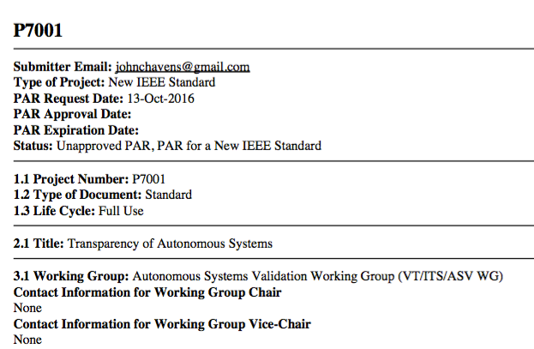
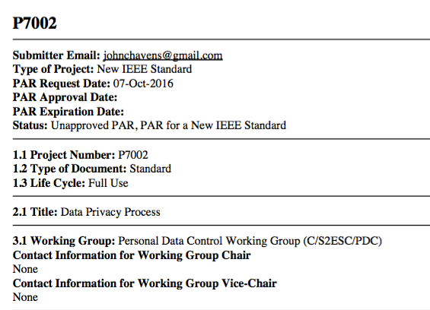
Deliverables
New Standard Projects – Join the Working Groups!
(P7001) Transparency of Autonomous Systems (P7002) Data Privacy Process

Slide 23
Deliverables more new standards
P7000 - Model Process for Addressing Ethical Concerns During System Design
P7001 - Transparency of Autonomous Systems
P7002 - Data Privacy Process
P7003 - Algorithmic Bias Considerations
P7004 - Child and Student Data Governance
P7005 - Transparent Employer Data Governance
P7006 - Personal Data AI Agent
P7007 - Ontological Ethically Driven Robotics and Automation Systems
P7008 - Ethically Driven Nudging for Robotic, Intelligent and Autonomous Systems
P7009 - Fail-Safe Design of Autonomous and Semi-Autonomous Systems

Slide 24
Work Process

Slide 25
Meetings

Slide 26




Organization - Committees
Executive Committee
Global Oversight and Strategic Leadership
Content Committees
Create content for EAD / Standards Projects
Includes Eight Committees creating content for Dec Doc
Includes Four new Committees creating content for Austin
Advisory Committees
Lexonomy, Drafting, Ecosystem Mapping, Standards
Ongoing advisory role to Content Committees
Overseen by Executive Committee

Slide 27
Thank you!
The Global Initiative for Ethical Considerations in Artificial Intelligence and Autonomous Systems
Ethically Aligned Design, v1 Report: http://standards.ieee.org/develop/indconn/ec/autonomous_systems.html
Contact: Dr Victoria Wang
victoriawang@hotmail.co.uk

